Slide 1


Progress Report: 4
Team Charlie
Aakansha Bhatt, Anshu Paudyal, Ingmar Diaz, Michael Foster, Raunaq Chopra, Yang Ye
29th January 2021

Slide 2
Teamwork via zoom
We explain the work done together as a team:
Completed the most of the altium design
Improved motor run time by increasing capacitance
Purchased New OLED displays

Slide 3
Aakansha Bhatt
Last week 3 | This week 4
Hardware: N/A | Hardware: N/A
Mechanical: N/A | Mechanical: N/A
Firmware: Trying to implement the Speedometer using a different sensor. I was trying to do research about the speedometer code and sensor with another group. Also researched about OLED. | Firmware: This week, I plan on completing the speedometer code (working model - currently it only shows zeroes). I will also talk with Michael and Ingmar and try to use the PSoC6 for OLED.
Software: same as above | Software: same as above

Slide 4
Anshu Paudyal
Last week 3 | This week 4
Hardware: Last week we concluded that 18F capacitor can sustain the rover for 1 second with 11.1v from the solar panel. Therefore I had to increase the capacitance value to sustain the motor for longer time. Single pole double throw switch was implemented to have the charging and discharging of the capacitor. | Hardware: In progress of getting the rover to run for 8sec. The power analysis was done again in the beginning of week 4. Had meeting with Nick A and ordered 10, 0.1F capacitor and couple switches. It arrived on Friday therefore I will be done testing by weekend. Two more SPDT switches were ordered, one of the charging and discharging of the capacitor and other for the connection of the rover with its controller. I will be assembling the rover will all the system and also communicating with the controller.
Mechanical: N/A | Mechanical: N/A
Firmware: N/A | Firmware: started on the documentation: created table of content and things to be added for the alpha prototype
Software: N/A | Software: N/A

Slide 5

Anshu Paudyal

Slide 6
Ingmar Diaz
Last week 3 | This week 4
Hardware: Finish Altium Design by weekend with Raun | Hardware: Finished most of altium design Waiting to implement some components and verifying connections with team
Mechanical: Finished Flow chart | Mechanical:
Firmware: Researched OLED displays Need to sync with Aakansha and micahel | Firmware: Ordered new OLED displays need to sync with Michael and Aakansha most likely end of week 5
Software: Test Aakansha’s speedometer code | Software: Code in PSOC so that we are able to display most likely end of week 5

Slide 7
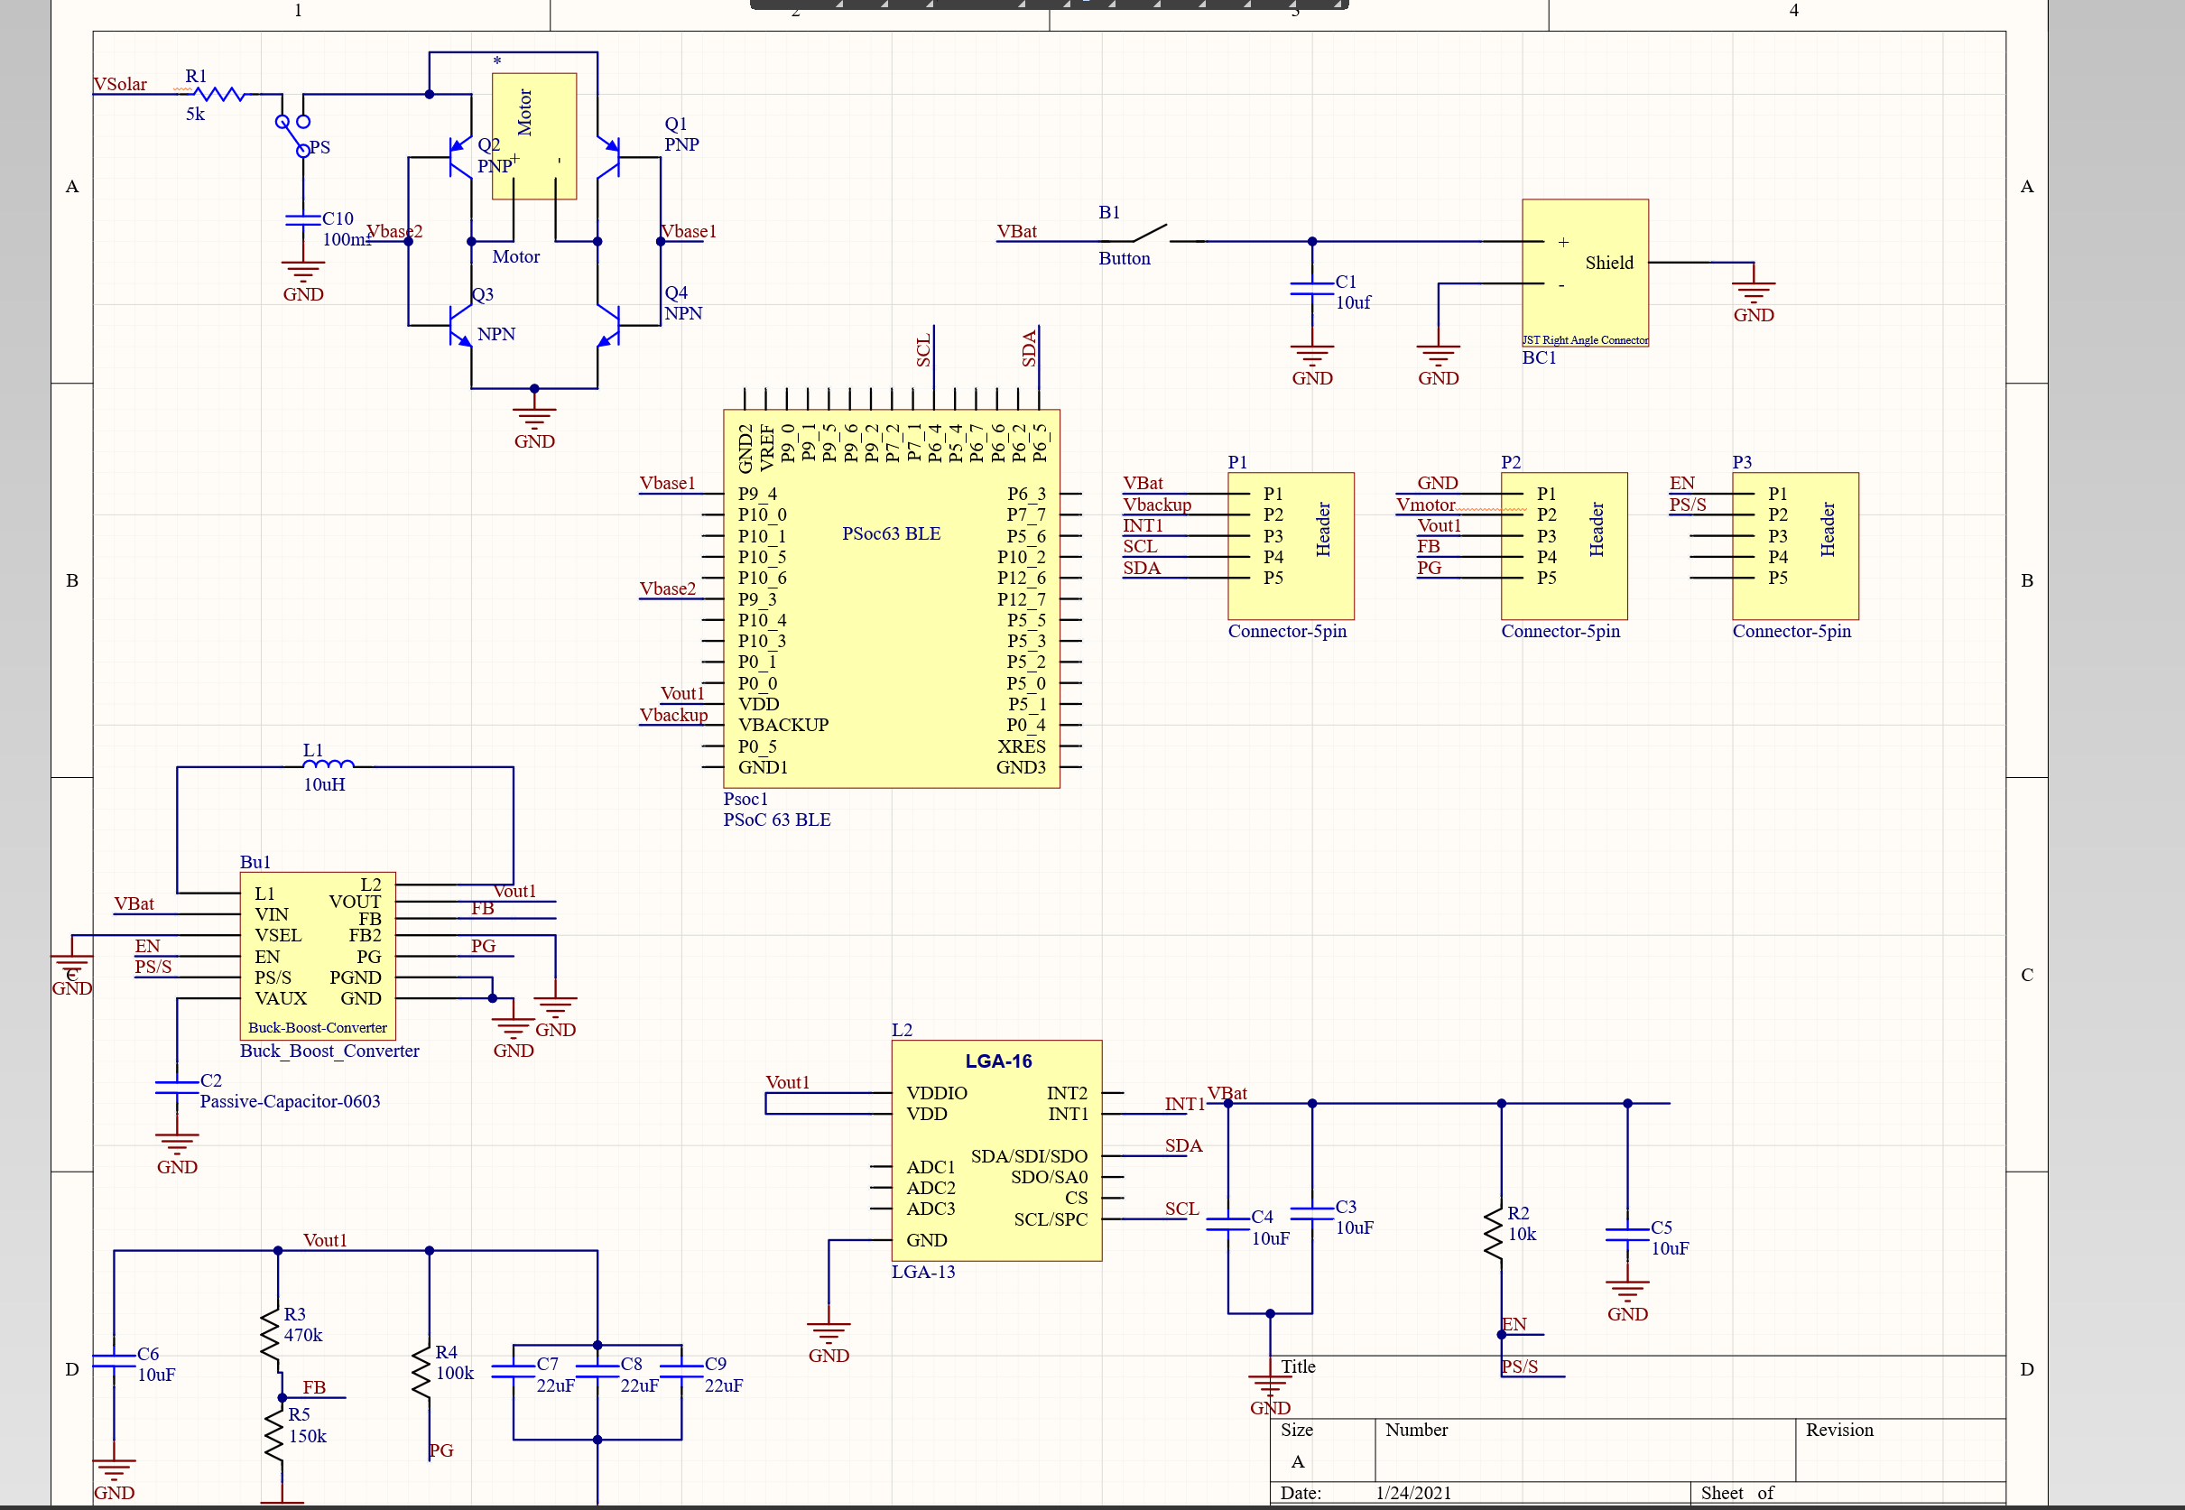
Ingmar Diaz & Raunaq Chopra
Altium Schematic

Slide 8
Michael Foster
Last week 3 | This week 4
Hardware: Built and designed a mechanical Voltage regulator. | I had midterms this week so I was trying to prepare for those. Next week I will try and get the Psoc to change LEDs when different voltage thresholds are met.
Mechanical: Mechanical Voltage Regulator | After speaking with professor he brought up a good point about power consumption from mechanical voltage regulator.
Firmware: N/A | We still might find a way to implement these LEDs in the final design.
Software: N/A

Slide 9
Michael Foster
Attached is the video of the first prototype of the mechanical voltage regulator. Will try to work on another way to implement this feature via Psoc next week.
Still need to meet up with Ingmar for the OLED display.

Slide 10
Raunaq Chopra
Week 3:
Hardware: Worked on Altium design (image in next slide) with Ingmar
Mechanical: Designed switch circuit mechanism for charging circuit. Ensures capacitor is either charging or running the motor at any specified time
Week 4:
Hardware: Waiting for a few finalized parts to implement the final Altium design

Slide 11
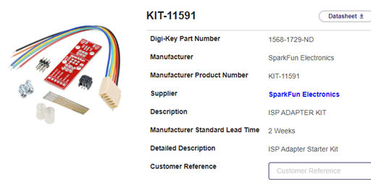
Yang Ye
Hardware: The video captured by the camera on the rover can be transmitted remotely to a receiver. The data stream will be then processed by the PC terminal. using OpenCV libraries)
Firmware: Researching the plan for USB signal converter.
Software: Researching and installing OpenCV library.

Slide 12
Bill of Materials and Project Budget: Rover Truck and Solar Panels~~$87.42
Project Schedule and Risk Assessment: MILESTONES - Google Docs
Report and Presentation: No date yet.
Marketing and Video: No date yet.
Tips:
1. Be sure to identify tasks and contributions of each team member.
2. Use pictures as much as possible for effective communication.

